Slide 2
The most listened musical genres in Karlovac
Turbo folk
House
Rock
Pop

Slide 3
Turbo folk
Originated in Serbia
Popular in Bosnia and Herzegovina, Croatia and Montenegro
One of the most popular tubro folk singers :
- Lepa Brena
- Mile Kitić
- Ceca
- Boban Rajović
- Dragana Mirković

Slide 4
Boban Rajović and Dragana Mirković

Slide 5
House
One of the most listened house performers in Karlovac :
- David Guetta
- Pitbull
- LMFAO
- Lady Ga-Ga
- Don Omar

Slide 6
Don Omar

Slide 7
Rock
One of the most listened foreign bands in our town :
- Green Day
- Guns & Roses
- U2
-Metallica
Croatian rock bands : - Opća Opasnost
- Hladno Pivo
- Parni Valjak

Slide 8
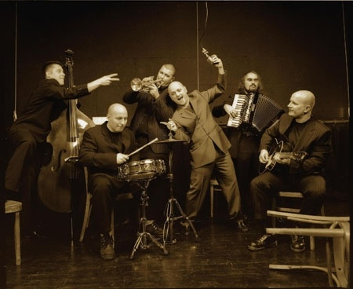
Hladno Pivo

Slide 9
Pop
The most listened foreign pop singers :
- Michael Jackson
- Madonna
- Britney Spears
- Adele
Croatian pop singers and groups :
- Tony Cetinski
- Colonija
-Feminem
- Nina Badrić

Slide 10
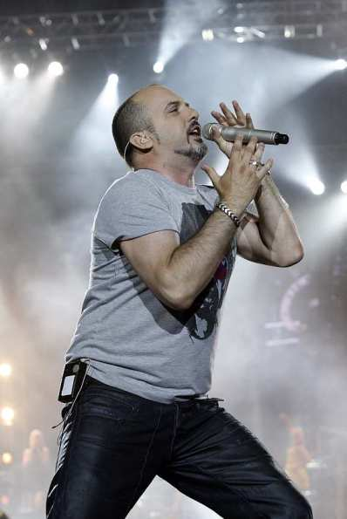
Tony Cetinski

Slide 11
The End

